Slide 1

Hypothesis Testing: Chapter 17

Slide 2


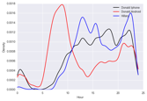
NOW
Formulate Question or Problem
Acquire and Clean Data
?
Inferential statistics
Hypothesis testing
Prediction
and inference
Exploratory Data Analysis
Reports, Decisions, and Solutions

Slide 3

HYPOTHESIS TESTING (also known as A/B Testing)
If there is sufficient evidence favoring the alternative hypothesis, we reject the null hypothesis
Otherwise, we fail to reject the null hypothesis
Example: We want to test whether the mean GPA of college students is different from 2.0.
Null hypothesis 𝑯_{𝟎}: mean=2.0
The alternative hypothesis is 𝑯_{𝒂}: mean≠2.0
Exercise: We want to test whether chocolate has effect on cardiac disease. What are the null and alternative hypotheses?
𝑯𝟎: Chocolate does not have an effect on cardiac disease
𝑯𝒂: Chocolate has an effect on cardiac disease
Notes:
The word “null” reinforces the idea that if the data look different from what the null hypothesis predicts, the difference is due to nothing but chance.
From a practical perspective, the null hypothesis is a hypothesis under which you can simulate data.
The choice between the null and alternative hypotheses depends on the comparison between the observed value of the test statistic and its distribution as predicted by the null hypothesis.
If the two are not consistent with each other, then the data do not support the null hypothesis. In other words, the alternative hypothesis is better supported by the data. We say that the test rejects the null hypothesis.
If the two are consistent with each other, then the observed test statistic is in line with what the null hypothesis predicts. In other words, the null hypothesis is better supported by the data. We say that the data are consistent with the null hypothesis.

Slide 4
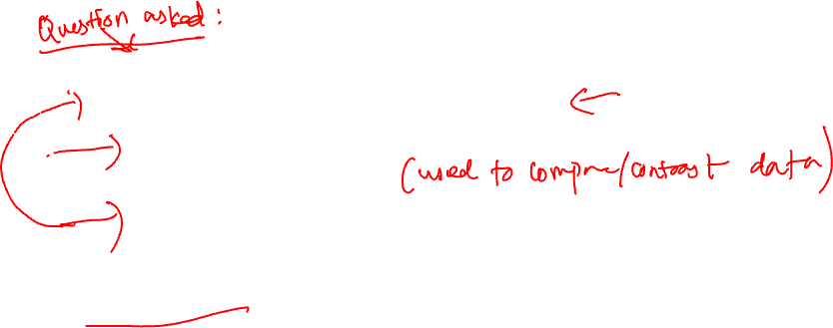
STEPS OF HYPOTHESIS TESTING
Specify the null hypothesis 𝑯𝟎 and the alternative hypothesis 𝑯𝒂
Specify the significance level threshold 𝜶_{t}
Collect the data
Calculate the test statistic
Calculate the corresponding 𝒑-value
Compare the 𝒑-value with the significance level
Determine whether to reject or fail to reject the null hypothesis 𝑯𝟎

Slide 5
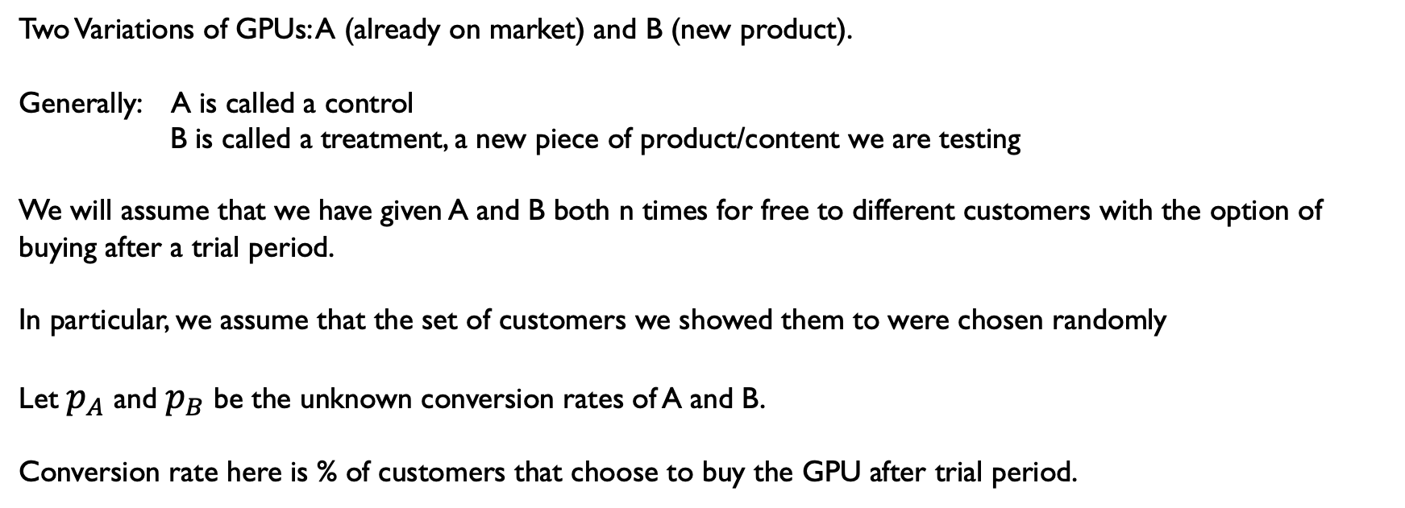
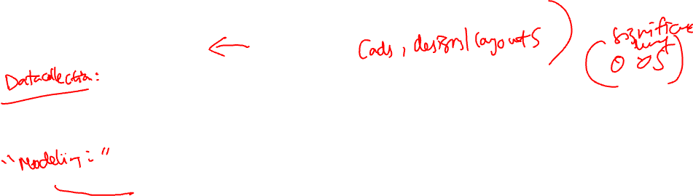
Example Setup
Two Variations of GPUs: A (already on market) and B (new product).
Generally: A is called a control
B is called a treatment, a new piece of product/content we are testing
We will assume that we have given A and B both n times for free to different customers with the option of buying after a trial period.
In particular, we assume that the set of customers we showed them to were chosen randomly
Let $p_{A}$ and $p_{B}$ be the unknown conversion rates of A and B.
Conversion rate here is % of customers that choose to buy the GPU after trial period.

Slide 6
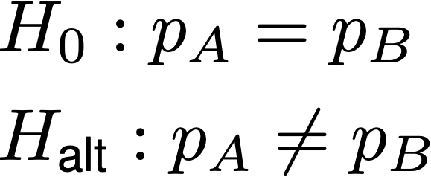
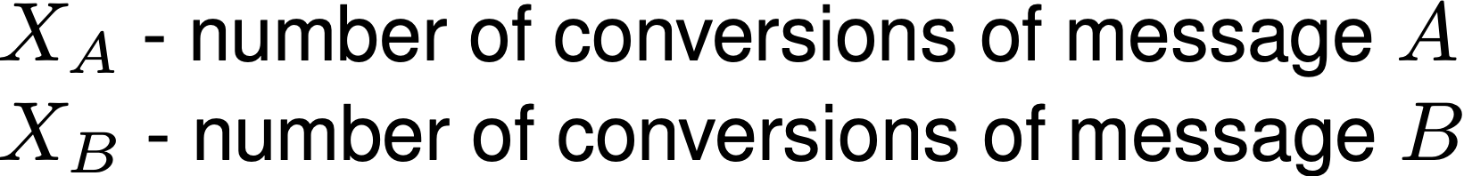
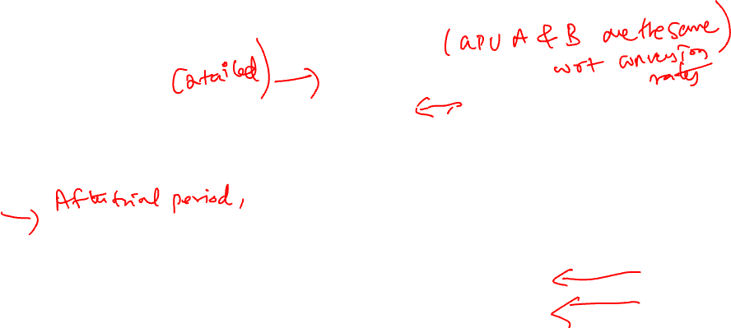

Formal Setup
Problem Formulation: Is there a difference between the treatment and control? If there is, is it significant? Which one is better?
If testing for better, can use $H_{\text{alt}} :{ p}_{A}<p_{B}$ That is, conversion rate of B is greater than B (A is the default GPU, so this means that we are testing if B is better than A)
Experiment: Show both variations n times to customers at random
Data: Raw data would consist of 0, 1 when a customer chooses to buy the product.
With this we first calculate,

Slide 7
STEPS OF HYPOTHESIS TESTING
Specify the null hypothesis 𝑯𝟎 and the alternative hypothesis 𝑯𝒂
Specify the significance level threshold 𝜶_{t}
Collect the data
Calculate the test statistic
Calculate the corresponding 𝒑-value
Compare the 𝒑-value with the significance level
Determine whether to reject or fail to reject the null hypothesis 𝑯𝟎

Slide 8
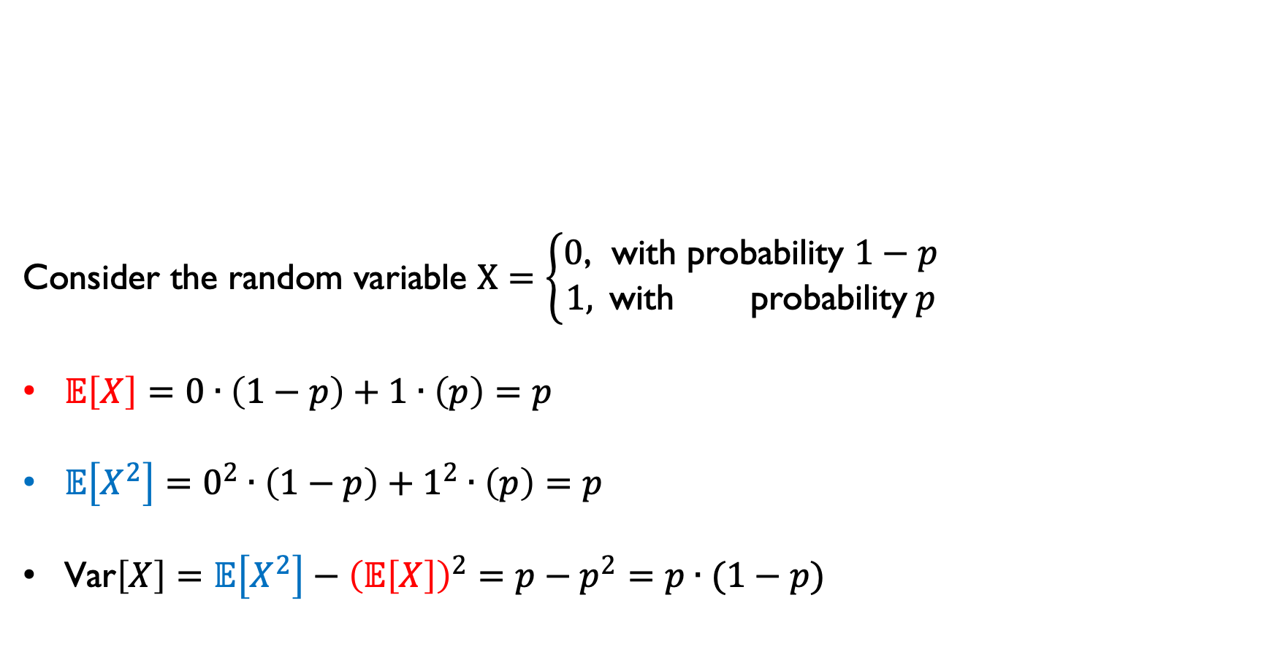
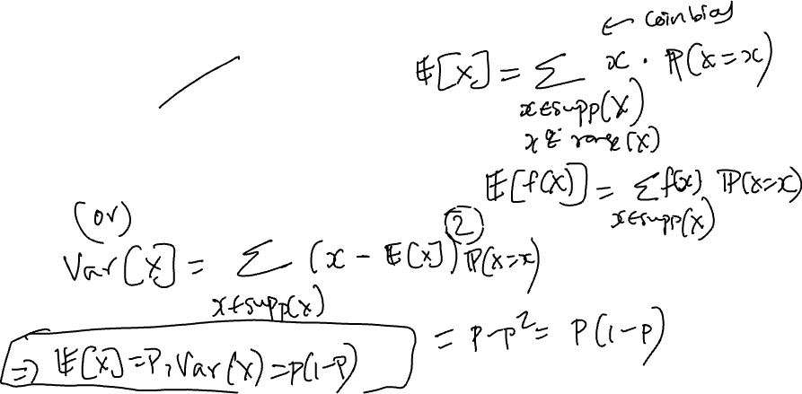
Useful Calculations/Formulas for binary random variables
Consider the random variable $X=\left\{\begin{aligned}0\text{, }\text{with} \text{probability} 1−p \\ 1, \text{wit}\text{h} \text{probability} p\end{aligned}\right.$
$𝔼\left[X\right]=0∙\left(1−p\right)+1∙\left(p\right)=p$
$𝔼\left[X^{2}\right]=0^{2}∙\left(1−p\right)+1^{2}∙\left(p\right)=p$
$\text{Var}\left[X\right]=$ $𝔼\left[X^{2}\right]−{\left(𝔼\left[X\right]\right)}^{2}=p−p^{2}=p∙(1−p)$

Slide 9
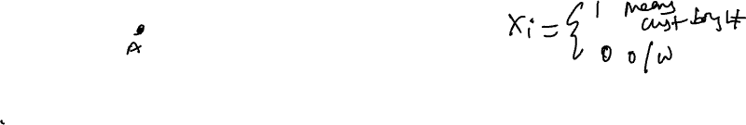
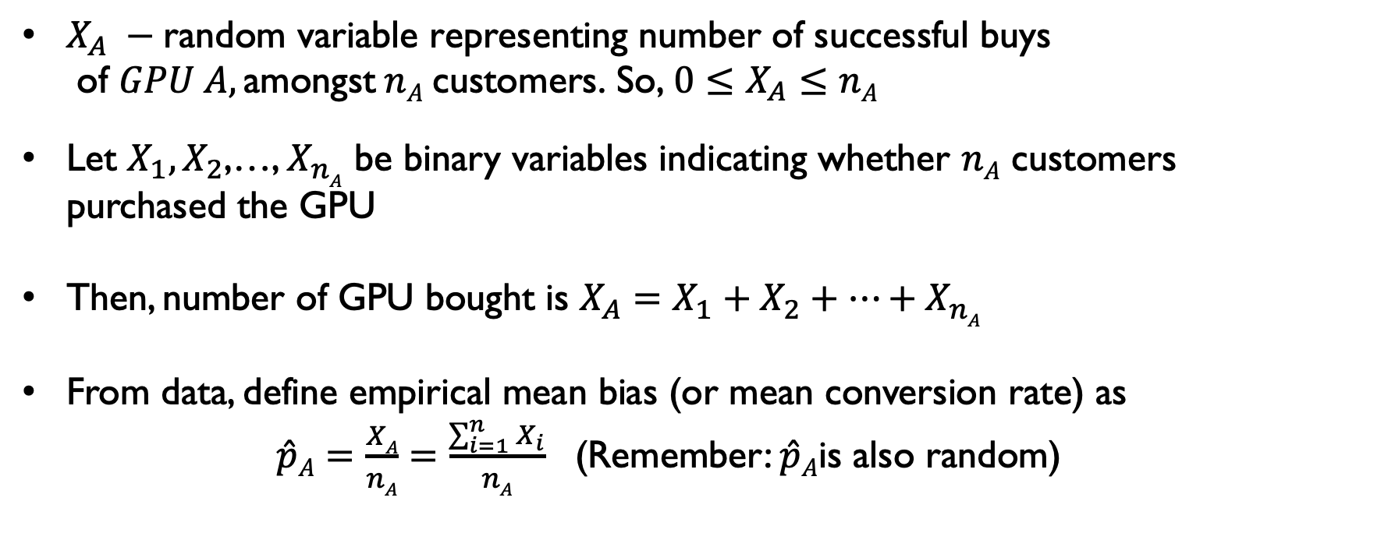
Test Statistic derivation
Consider GPU A (similar for B): Assume/Represent a conversion or a success as getting a heads on flipping a coin with bias $p_{A}$
$X_{A} −\text{random} \text{variable} \text{representing} \text{number} \text{of} \text{successful} \text{buys} \text{of} GPU A, \text{amongst} nA \text{customers}\text{.} \text{So}\text{,} 0≤X_{A}≤nA$
Let $X_{1},X_{2}$,…, $X_{nA}$ be binary variables indicating whether $nA$ customers purchased the GPU
Then, number of GPU bought is $X_{A}=X_{1}+X_{2}+…+X_{nA}$
From data, define empirical mean bias (or mean conversion rate) as
$\hat{p}A=\frac{XA}{nA}=\frac{\sum_{i=1}^{n}{X_{i}}}{nA}$ (Remember: $\hat{p}A$is also random)

Slide 10

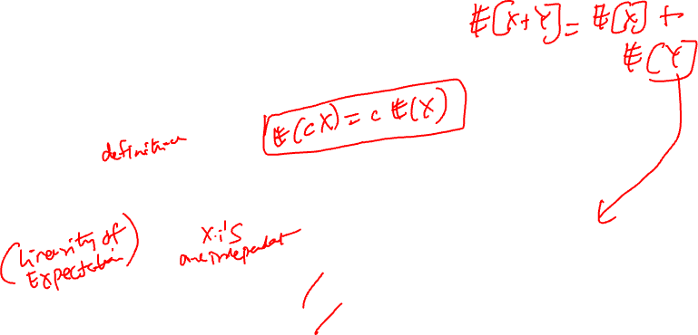
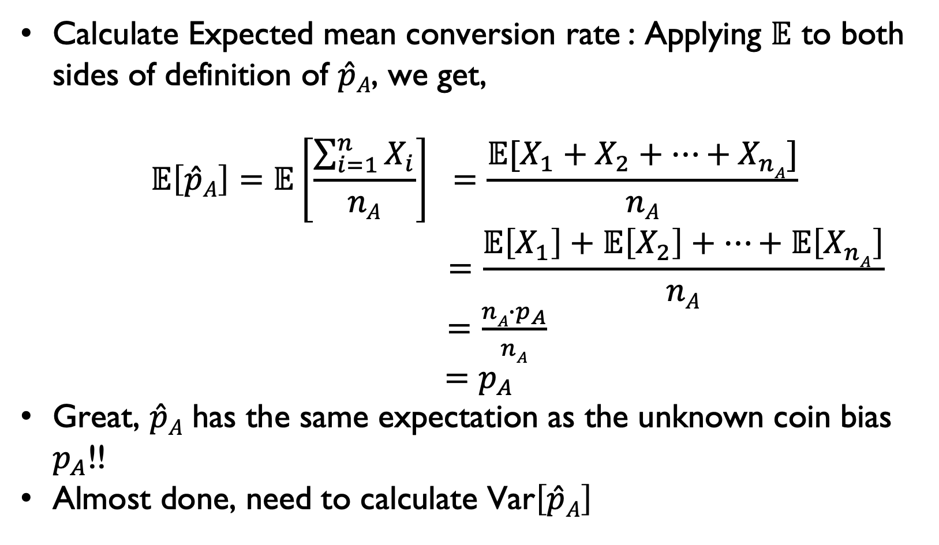
Step 1: Relate unknown $p_{A}$to data using$𝔼$
Calculate Expected mean conversion rate : Applying $𝔼$ to both sides of definition of $\hat{p}A$, we get,
$$𝔼\left[\hat{p}A\right]=𝔼\left[\frac{\sum_{i=1}^{n}{X_{i}}}{nA}\right] =\frac{{𝔼[X}_{1}+X_{2}+…+X_{nA}]}{nA} \\ =\frac{𝔼\left[X_{1}\right]+𝔼\left[X_{2}\right]+…+𝔼\left[X_{nA}\right]}{nA}$$
$=\frac{nA∙p_{A}}{nA}$
$=p_{A}$
Great, $\hat{p}A$ has the same expectation as the unknown coin bias $p_{A}$!!
Almost done, need to calculate $\text{Var}\left[\hat{p}A\right]$

Slide 11

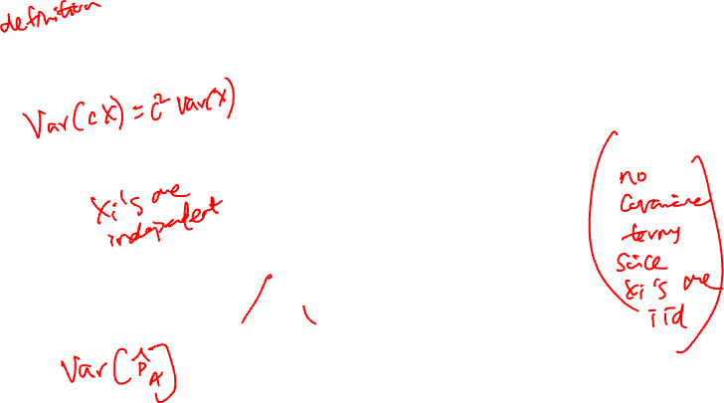
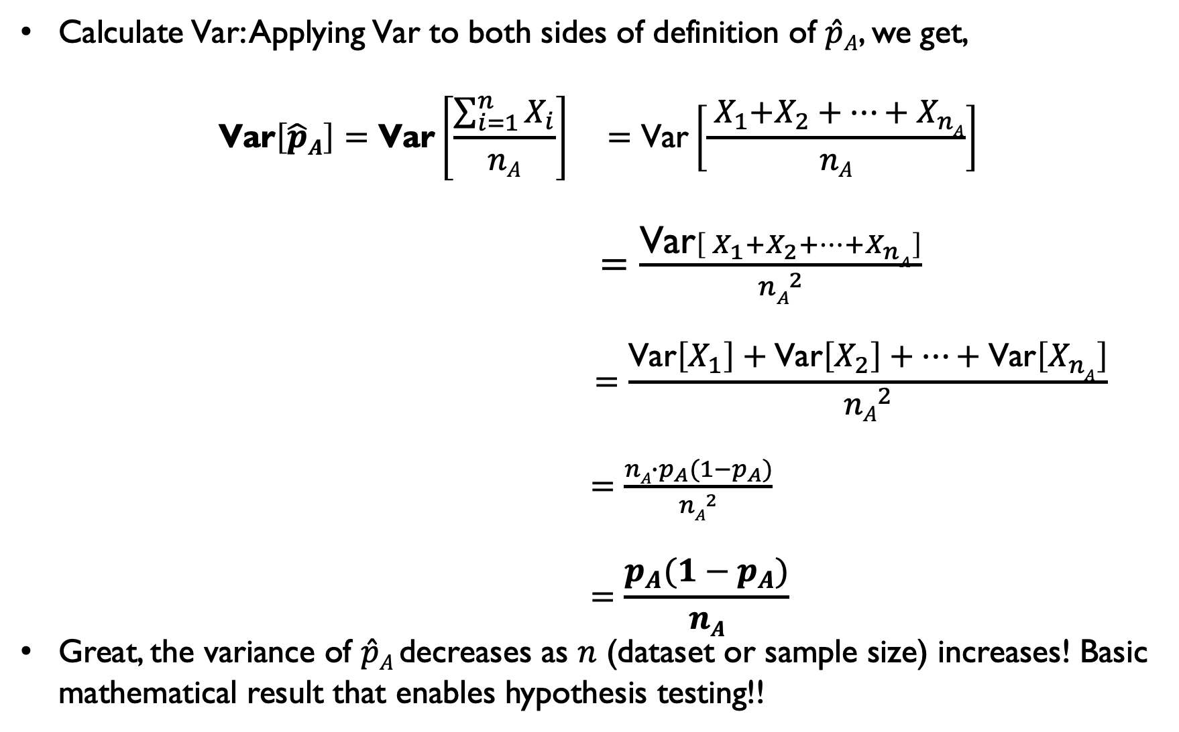
Test Statistic derivation: Relate unknown $p_{A}$to data using $\text{Var}$
Calculate$\text{Var}$: Applying$\text{Var}$ to both sides of definition of $\hat{p}A$, we get,
$$\text{Var}\left[\hat{p}A\right]=\text{Var}\left[\frac{\sum_{i=1}^{n}{X_{i}}}{nA}\right] =\text{Var}\left[\frac{{ X}_{1}+X_{2}+…+X_{nA}}{nA}\right]$$
$=\frac{\text{Var}\left[{ X}_{1}+X_{2}+…+X_{nA}\right]}{{nA}^{2}}$
$$=\frac{\text{Var}\left[X_{1}\right]+\text{Var}\left[X_{2}\right]+…+\text{Var}\left[X_{nA}\right]}{{nA}^{2}}$$
$=\frac{nA∙p_{A}({1−p}_{A})}{{nA}^{2}}$
$$=\frac{p_{A}({1−p}_{A})}{nA}$$
Great, the variance of $\hat{p}A$decreases as $n$ (dataset or sample size) increases! Basic mathematical result that enables hypothesis testing!!

Slide 12
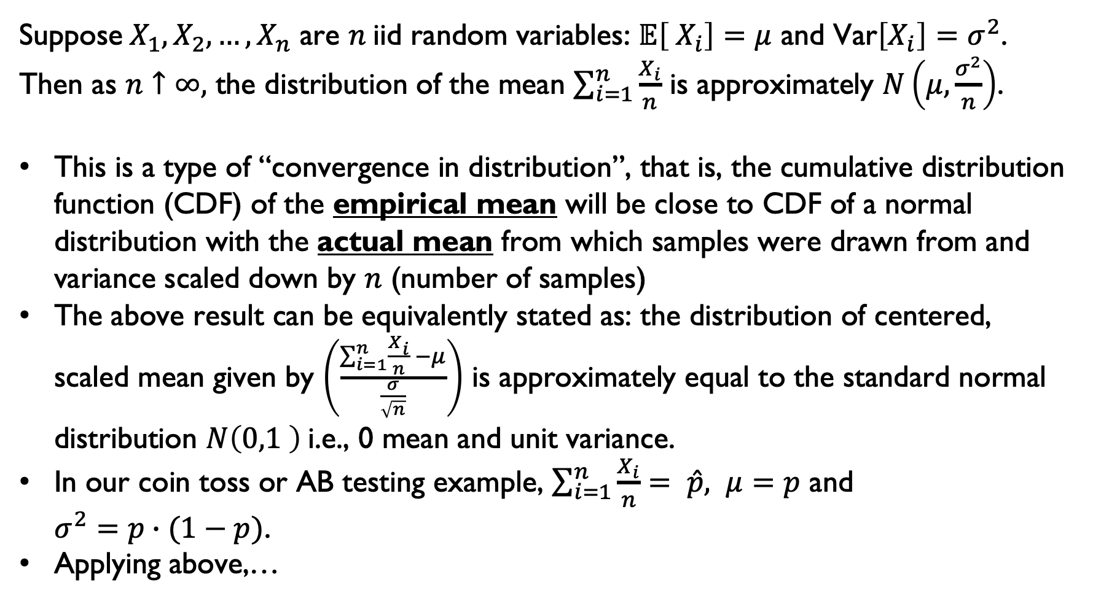
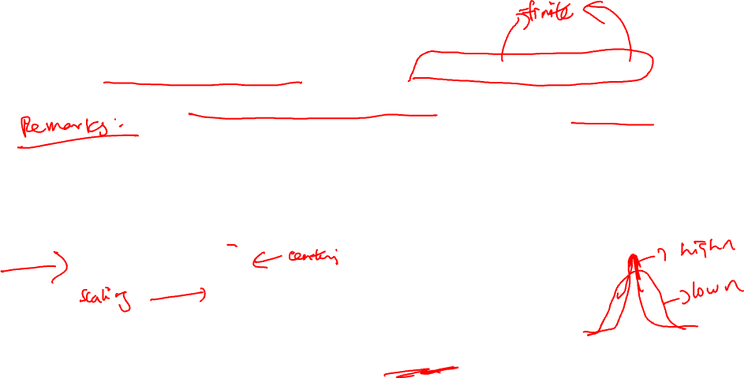
Very Very Useful Mathematical Result: Central Limit Theorem
Suppose${ X}_{1},X_{2},…,X_{n}$ are $n$iid random variables: $𝔼\left[{ X}_{i}\right]=μ$ and $\text{Var}\left[X_{i}\right]=σ^{2}$.
Then as $n↑∞,$ the distribution of the mean $\sum_{i=1}^{n}{\frac{X_{i}}{n}}$ is approximately $N\left(μ,\frac{σ^{2}}{n}\right)$.
This is a type of “convergence in distribution”, that is, the cumulative distribution function (CDF) of the empirical mean will be close to CDF of a normal distribution with the actual mean from which samples were drawn from and variance scaled down by $n$ (number of samples)
The above result can be equivalently stated as: the distribution of centered, scaled mean given by $\left(\frac{\sum_{i=1}^{n}{\frac{X_{i}}{n}} −μ}{\frac{σ}{\sqrt{n}}}\right)$ is approximately equal to the standard normal distribution $N\left(0,1 \right)$i.e., 0 mean and unit variance.
In our coin toss or AB testing example, $\sum_{i=1}^{n}{\frac{X_{i}}{n}}= \hat{p}, μ=p$ and $σ^{2}=p∙(1−p)$.
Applying above,…

Slide 13
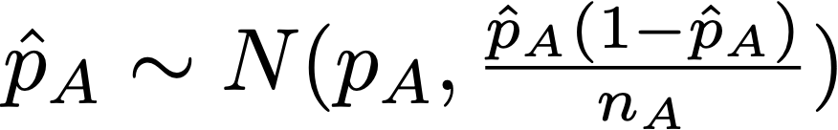
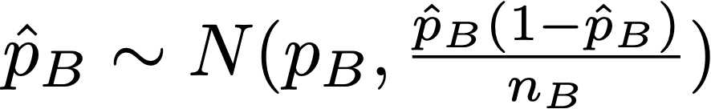
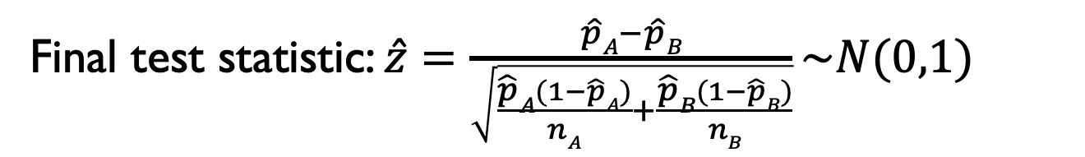
Test Statistic derivation
By the Central Limit Theorem,
By sum of independent normal random variables,
Using the null hypothesis,
Final test statistic: $\hat{z}=\frac{\hat{p}A−\hat{p}B}{\sqrt{\frac{\hat{p}A(1−\hat{p}A)}{nA}+\frac{\hat{p}B(1−\hat{p}B)}{nB}}}\sim N(0,1)$
Notes:
Do a sanity check - this goes to 0 as the number of samples goes up

Slide 14
STEPS OF HYPOTHESIS TESTING
Specify the null hypothesis 𝑯𝟎 and the alternative hypothesis 𝑯𝒂
Specify the significance level threshold 𝜶_{t}
Collect the data
Calculate the test statistic
Calculate the corresponding 𝒑-value
Compare the 𝒑-value with the significance level threshold
Determine whether to reject or fail to reject the null hypothesis 𝑯𝟎

Slide 15
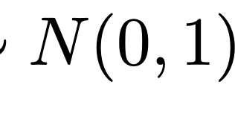
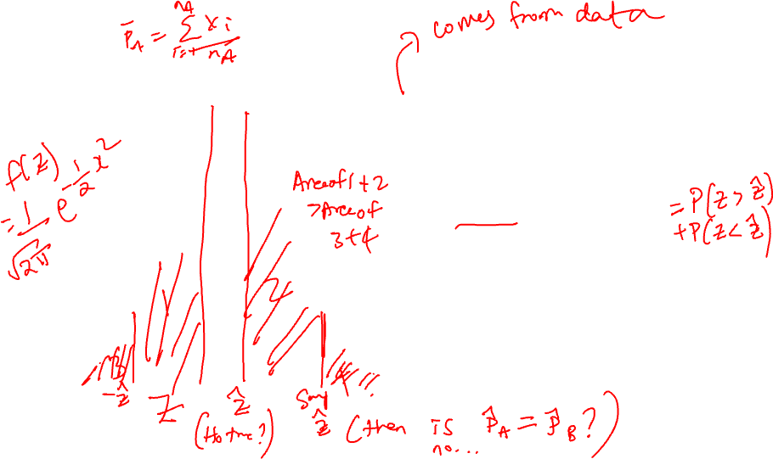
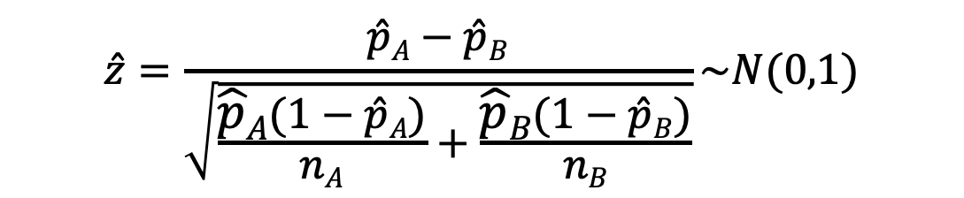
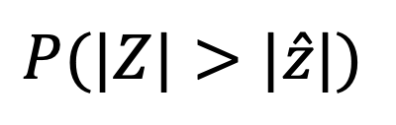
p-Value
$$\hat{z}=\frac{\hat{p}A−\hat{p}B}{\sqrt{\frac{\hat{p}A(1−\hat{p}A)}{nA}+\frac{\hat{p}B(1−\hat{p}B)}{nB}}}\sim N(0,1)$$
$$P(|Z|>|\hat{z}|)$$
p-value:
p-Value: If the null was true, and I redid this experiment, what is the probability of getting a result as extreme as what I got?
The gold standard in 20th century statistics for reporting the outcome of an experiment.

Slide 16
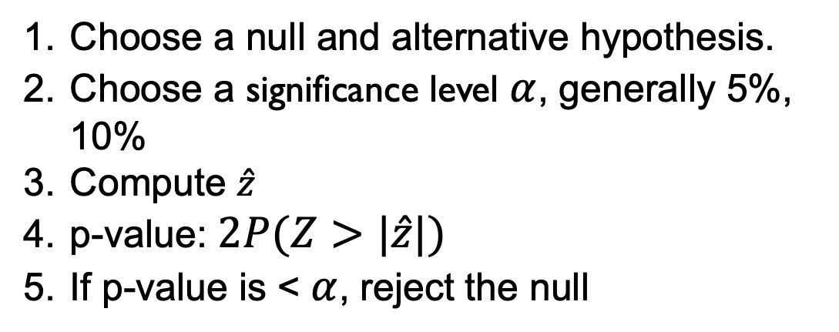
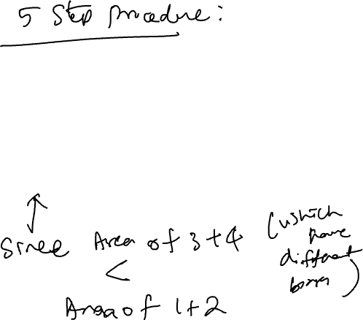
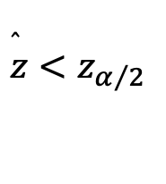
Running a Hypothesis Test
Choose a null and alternative hypothesis.
Choose a significance level $α$, generally 5%, 10%
Compute $\hat{z}$
p-value: $2P(Z>|\hat{z}|)$
If p-value is < $α$, reject the null
$$\overset{̂}{z}<z_{α/2}$$

Slide 17
ACKNOWLEDGMENTS
These slides use materials by the Berkeley DS 100 team, Elena Zheleva, Gonzalo Bello, Lalit Jain

